Slide 1
IPv6 Presentation Template
(Make this title your own!)

Slide 2
What’s happening with IPv4?
IPv4 exhaustion (link to RIRs and highlight relevant trends for your region)
Regional Internet Authorities are in various phases of IPv4 exhaustion
Cloud providers are acquiring IPv4 resources to power their services while they spin up IPv6
IPv4 acquisition costs are expected to be passed on to the downstream customer
With limited IPv4 resources available at the RIR level, companies will need to look at third party services

Slide 3
Why IPv6?
IPv6 provides a (MUCH) larger address space (Watch video)
Regional Internet Registries are in various phases of IPv4 exhaustion
Moving forward, the price of IPv4 addresses will only go up
You may need to rent addresses from large companies who have already bought considerable portions of the address space
IPv4 and IPv6 can be used together (dual stack)

Slide 4
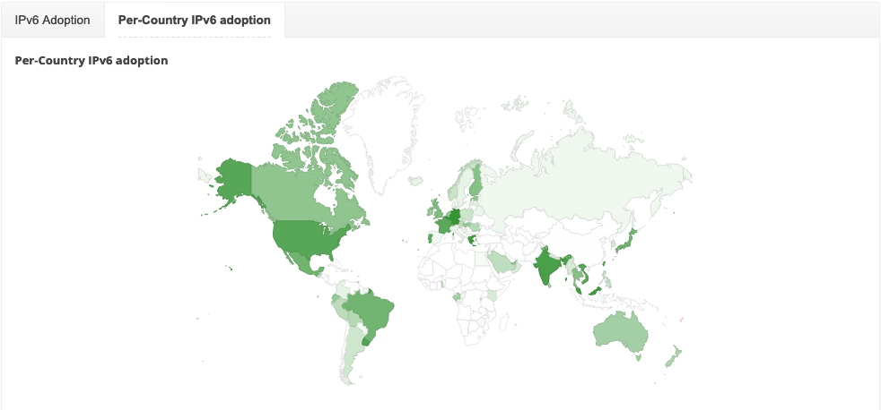
Global State of IPv6 Adoption
https://www.google.com/intl/en/ipv6/statistics.html#tab=per-country-ipv6-adoption

Slide 5
“Some kind of big bold quote that really helps put this into perspective.”
- Person we respect

Slide 6
The Power of IPv6: Automation
Greater integration with provisioning systems
Centralized systems that talk to each other, siloes need to be tamed!
API driven infrastructure

Slide 7
The Power of IPv6: Scalability
Scale of IPv6 requires non-spreadsheet based strategies
Thinking of IPs as “resource pools” instead of individual objects/hosts
How to you bring scalability to the forefront while updating internal processes?

Slide 8
The Power of IPv6: Speed
Shifting from NAT/CGN to ACLs
IPv6 brings about an evolution of your network management tools
Side effect of IPv6 is flattening of infrastructure
What used to require firewall rules, NAT and 1918 space can be reproduced more simply in IPv6 due to minimal translation needs
IPv6 can leverage ACLs readily to minimize network hops and efficient routing

Slide 9
IPv6 Solutions by Example 1
For your first example, you can start by sharing a starter project that can be IPv6 enabled. Something like an internal website/wiki or with the expansion of remote work, audit/survey of users with active IPv6 connections at their home offices.
The goal here is usually two fold:
Show that IPv6 exists “in the wild” and isn’t some far away goal
Show that your current users/partners/customers are already using it

Slide 10
IPv6 Solutions by Example 2
Another example might be shedding some light on the differences that IPv6 has regarding allocation planning. IPv4 environments are pretty easy to subnet and understand utilization. IPv6 changes things a bit - so share some examples.
For instance:
In our business, we manage hosts using this plan and have this utilization
In IPv6, we would use allocations in a similar way, but our pool(s) would be significantly bigger
For a fun read - check out https://www.howfunky.com/2015/06/ipv6-docker-and-building-for-scale.html?m=1 - has some great examples on the scale difference with IPv4 runout

Slide 11
IPv6 Solutions by Example 3
You are creative - think of something unique to your business that IPv6 could positively impact!

Slide 12
“An optional quote that really adds some emphasis to what we’ve covered”
- Person we respect

Slide 13
Call to Action
Tie this in to your business opportunities

